Slide 1
Group 8
Design Masterclass – Bandai Namco Brief
Max Carter & Rebecca Brannum

Slide 2
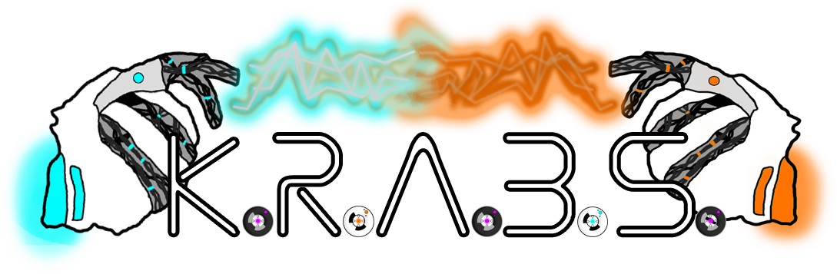
The Game
Killer Robotic Aquatic Battle Shockers
Game we created for Ludum Dare 38
Notes:
Adapting a game we created for Ludum Dare 38 Currently a windows standalone, we’ll be porting it to android, adjusting the mechanics to be appropriate for the brief

Slide 3


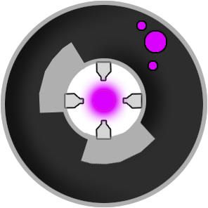

What is K.R.A.B.S?
2D
2 player
Single screen
Simultaneous, symmetrical play
Resource gathering and battling
Aimed at males 12-17
Notes:
Single screen 2 players 2D Simultaneous, symmetrical play Resource gathering + battling Currently just 1 level

Slide 4
What’s Changed?
Ported to Android as playable .apk
Touch screen controls
New menu
Instructions
Haptic feedback
Bug fixes

Slide 5
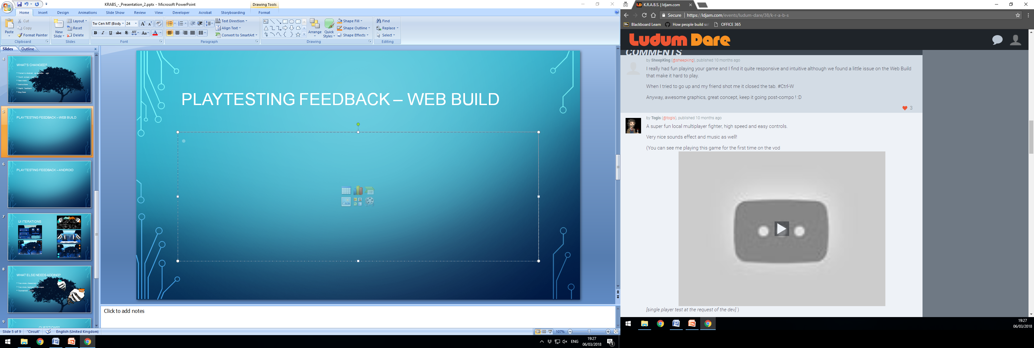
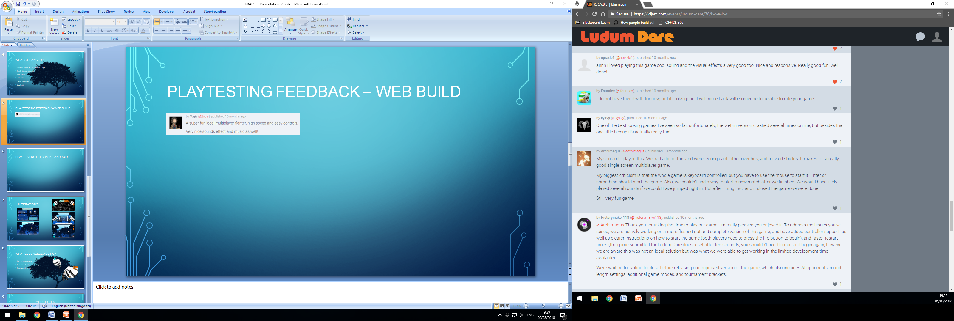
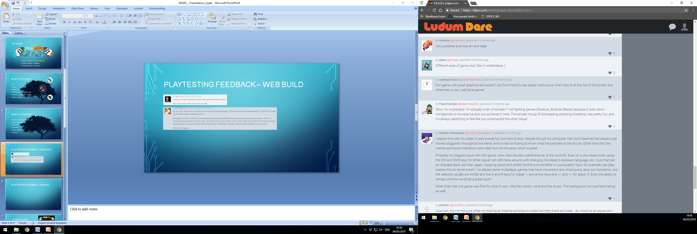
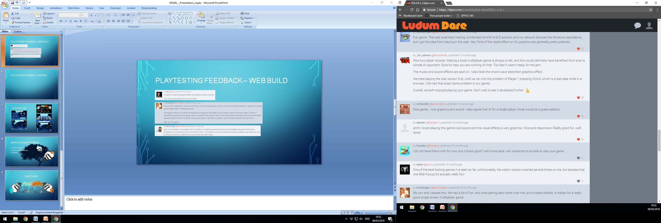
Playtesting Feedback – Ludum Dare

Slide 6
Playtesting Feedback – Web Build
Collectables are a bit small
Colour contrast issues
Acceleration inconsistencies
“Predicting bullets and shielding was really satisfying”
“I loved beating my friend at the last second”

Slide 7
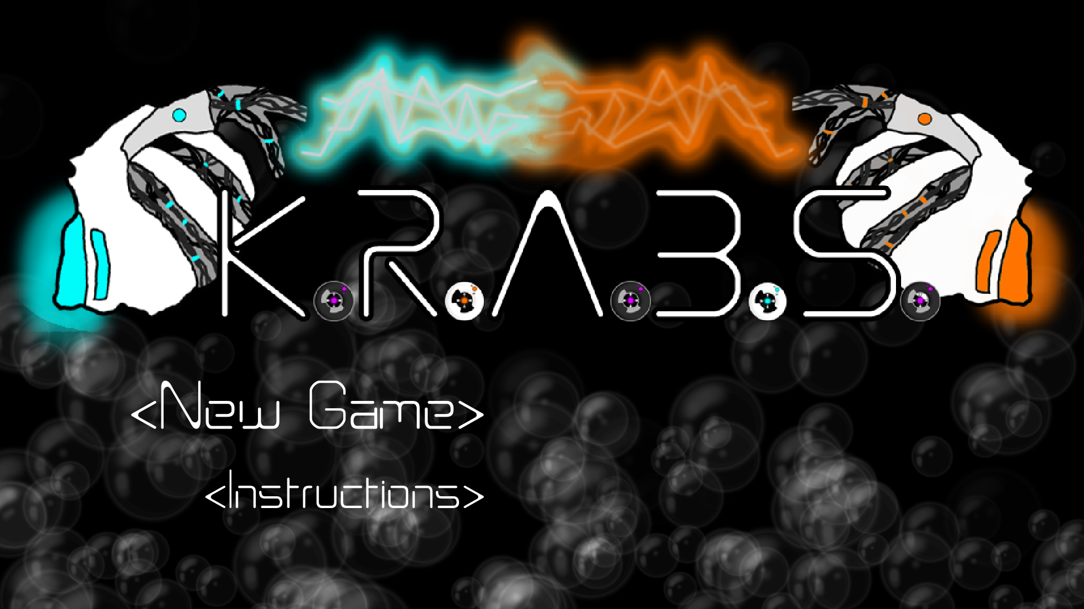
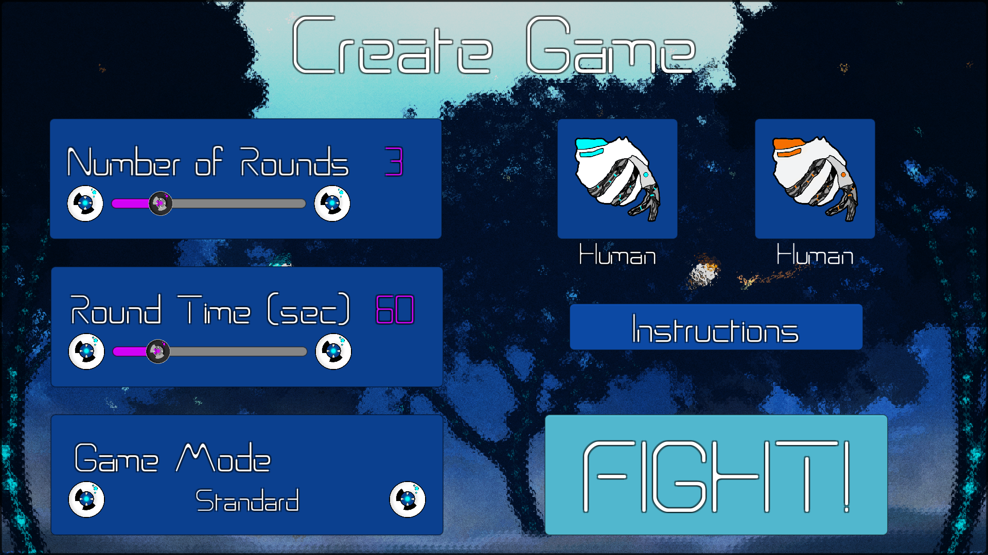
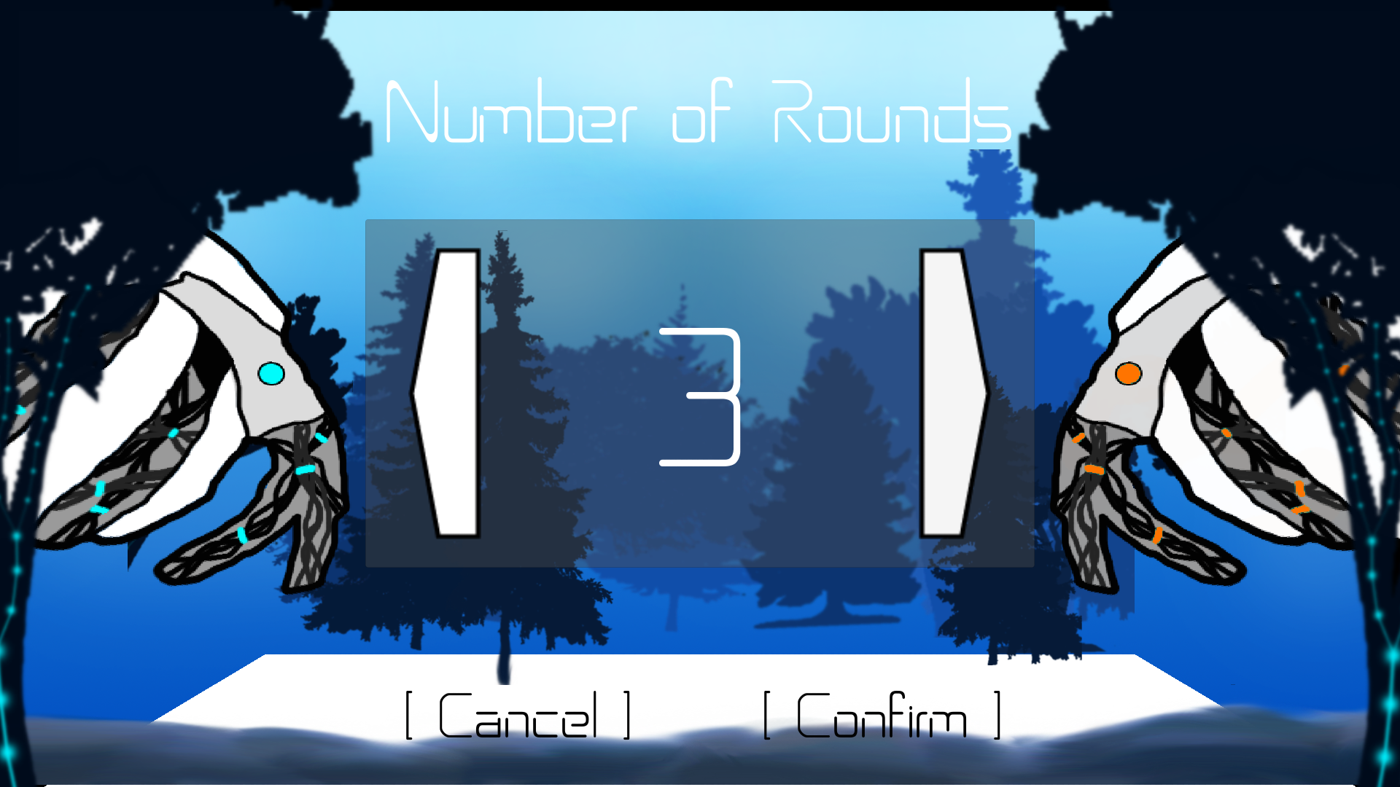
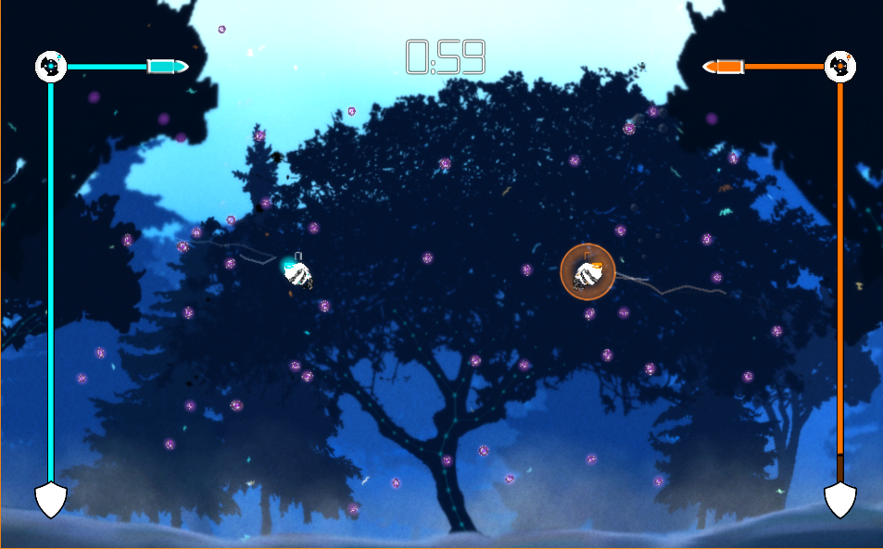
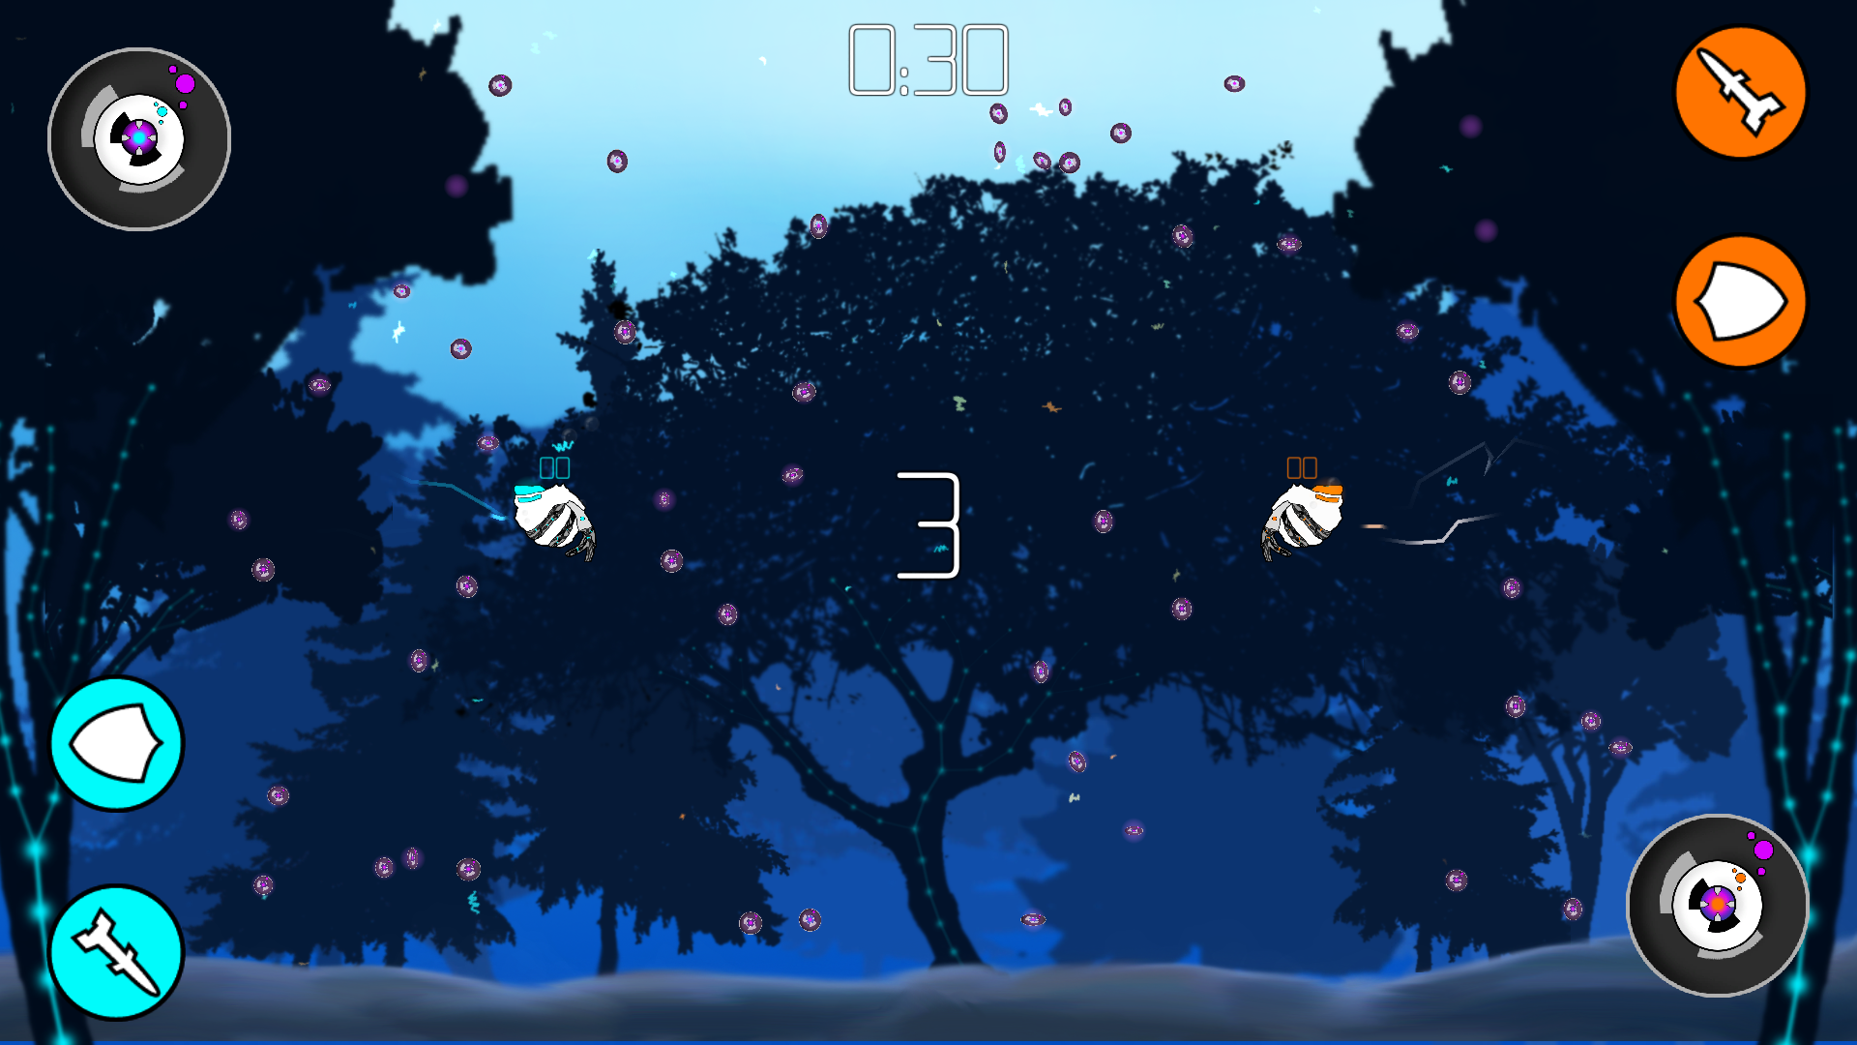
UI Iterations

Slide 8


Playtesting Feedback – android
Pre-Joystick Iterations
Tap and drag movement - obscured vision, lost track of character
UI not clear, bars hard to see on small screen
Post-Joystick Iterations
UI is more intuitive
Controls less clunky
Faster gameplay

Slide 9
Control Iterations

Slide 10
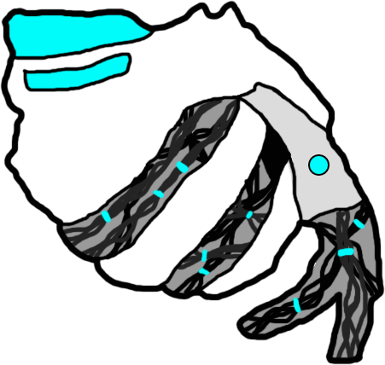
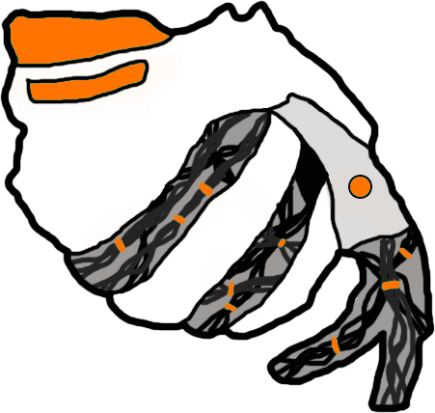
What next?
Additional characters (2+)
Additional environments (2+)
One additional game mode
Polishing mechanics
Polishing UI
Notes:
Add additional characters to choose from Animations for characters Stage selection Tournament mode Main menu (options)

Slide 11
Questions?

